Slide 1
Ort, Datum
Anlass
Vortragende

Slide 2
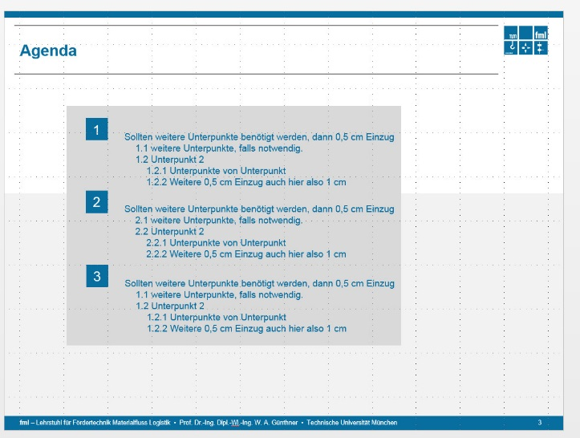
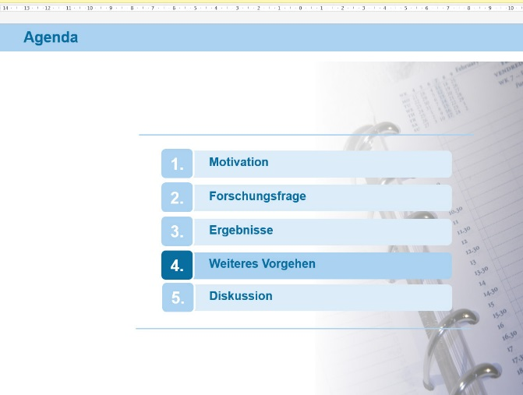
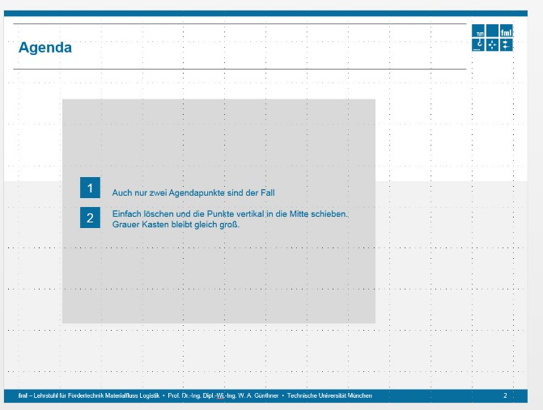
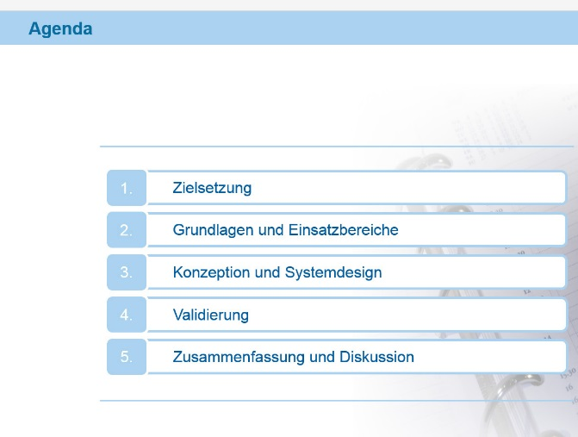
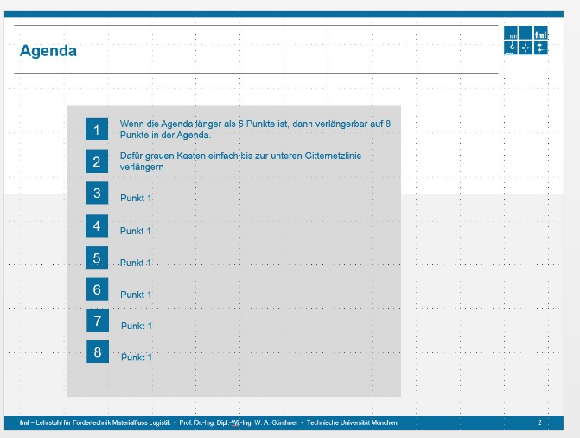
Agenda
1
Punkt 1
2
Punkt 1
Einheitliche Darstellung
3
Punkt 1
4
Punkt 1
5
Punkt 1
6
Punkt 1

Slide 4
Matlab GUI Hydropulse test band
Development
Offset value in the text box
calibration value on the legend
Multiple simulation data on a plot
Simulation data maximum 4

Slide 5
Matlab GUI Trommel test band
Development
Experimental data: .asc
Simulation data: .dat, 5 data value ( time/ force/ displacement/ 2 etc.)
deflection comparison

Slide 8
Experiment of forklift truck
Forklift truck
EFG 216k Jungheinrich
Max. loading capacity: 1600 kg
Tire
Front: 18 x 7 – 8
Rear: 15 x 5.5 - 9
Input data to experiment
Wheel load: 8000N and 16000N
Velocity: 2 km/h – 13 km/h
Threshold: 5mm and 10mm

Slide 9
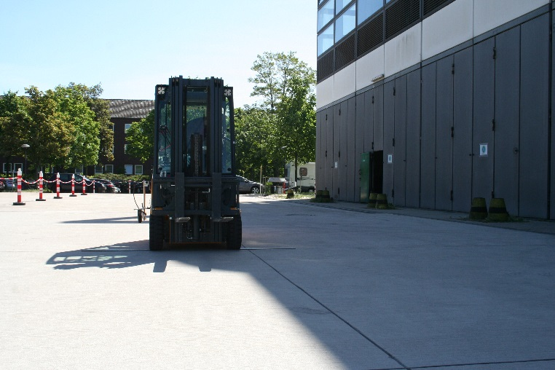
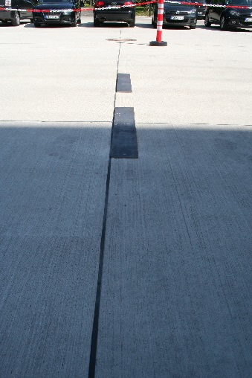
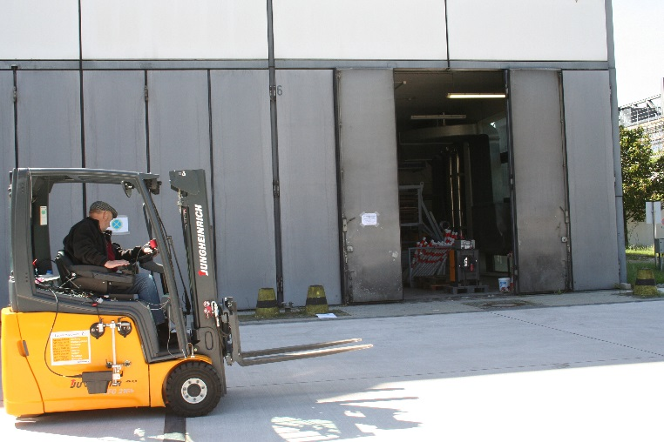
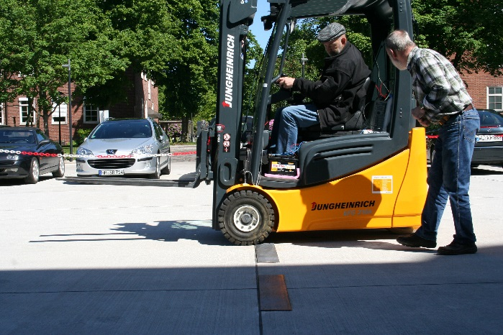
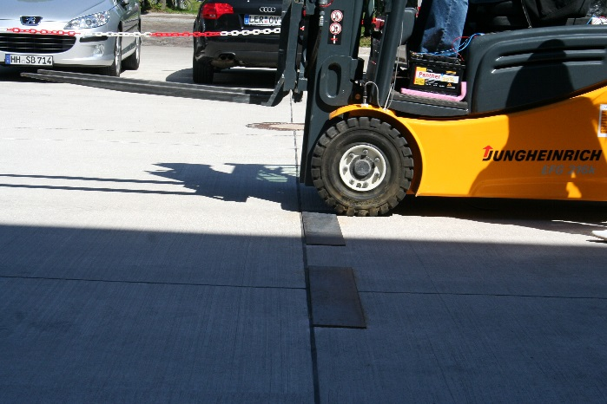
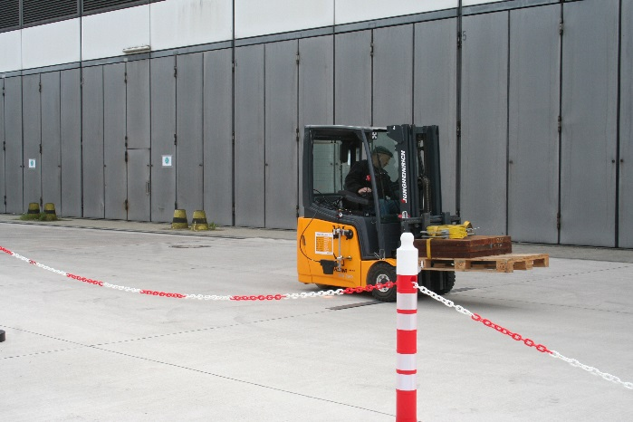
Experiment of forklift truck

Slide 10
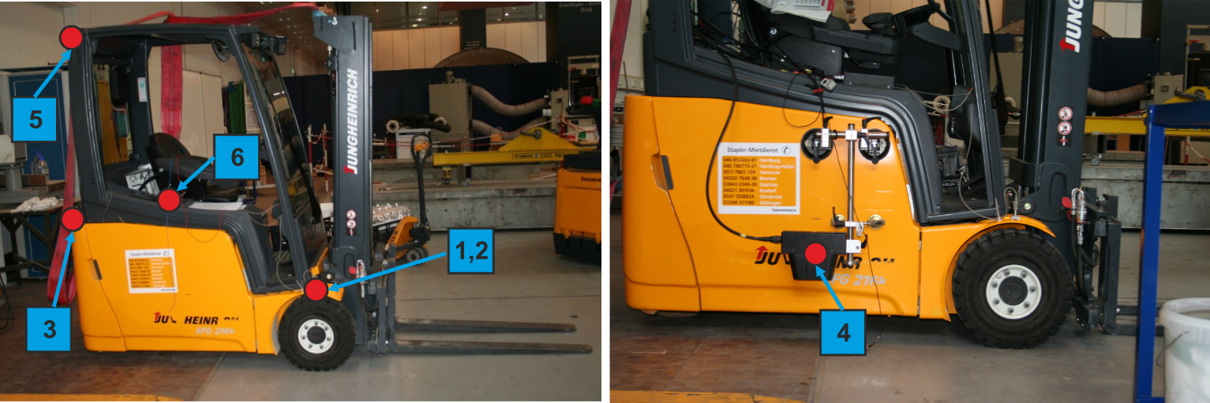
Position of all sensor
z
x
Sensor | dimension | measured | Description | Direction
1 | 1D | Acceleration [m/s2] | wheel axle right | z
2 | 1D | Acceleration [m/s2] | wheel axle left | z
3 | 1D | Acceleration [m/s2] | steering bracket | z
4 | 1D | Velocity [km/h] | frame | x
5 | 1D | Acceleration [m/s2] | at top left | x
6 | 1D | Acceleration [m/s2] | around to seat | z

Slide 11
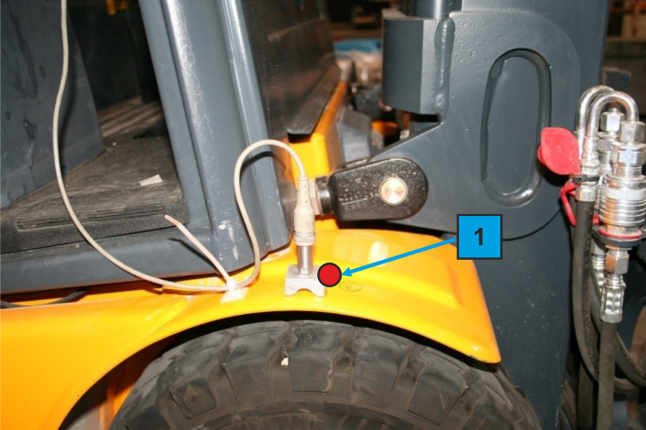
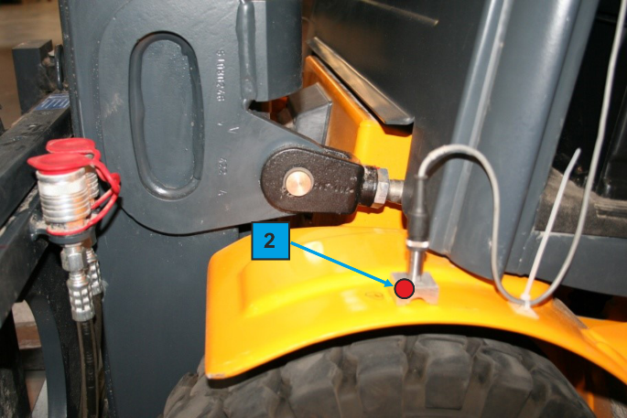
Position of sensor 1, 2

Slide 12
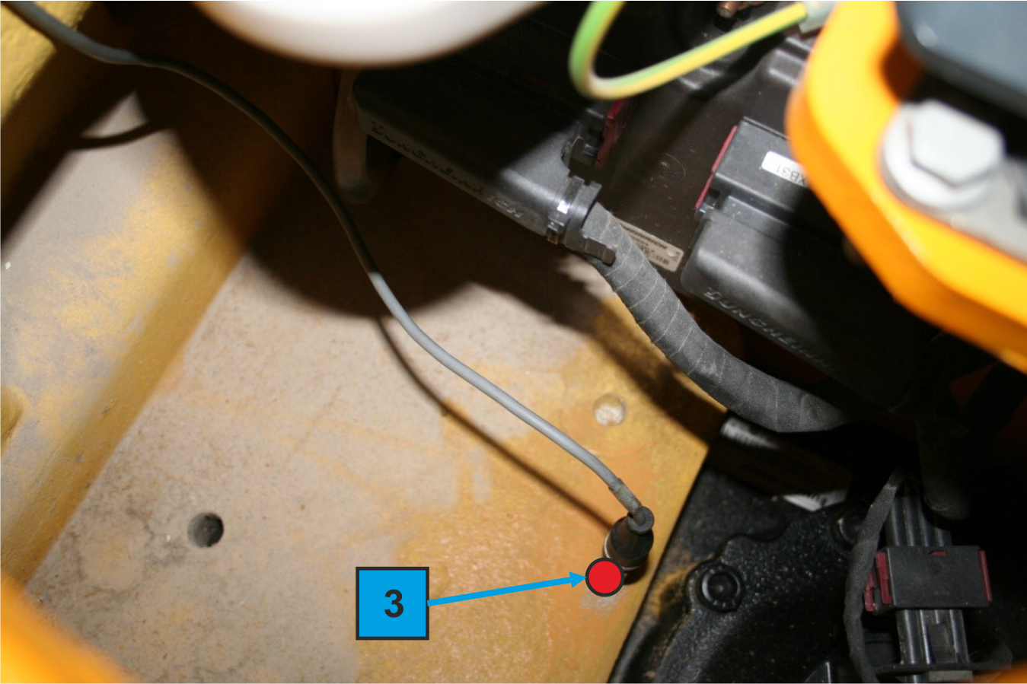
Position of sensor 3

Slide 13
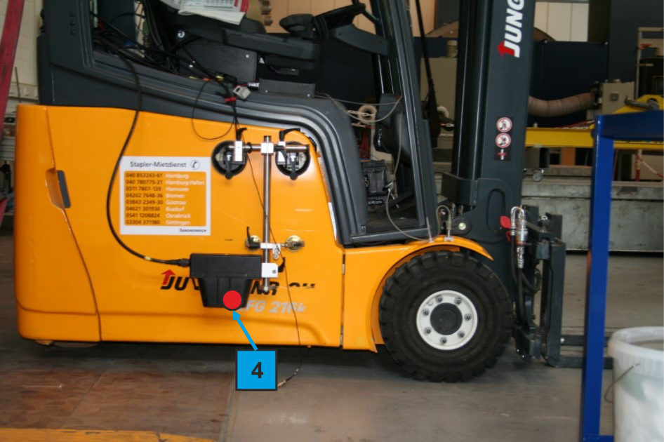
Position of sensor 4

Slide 14
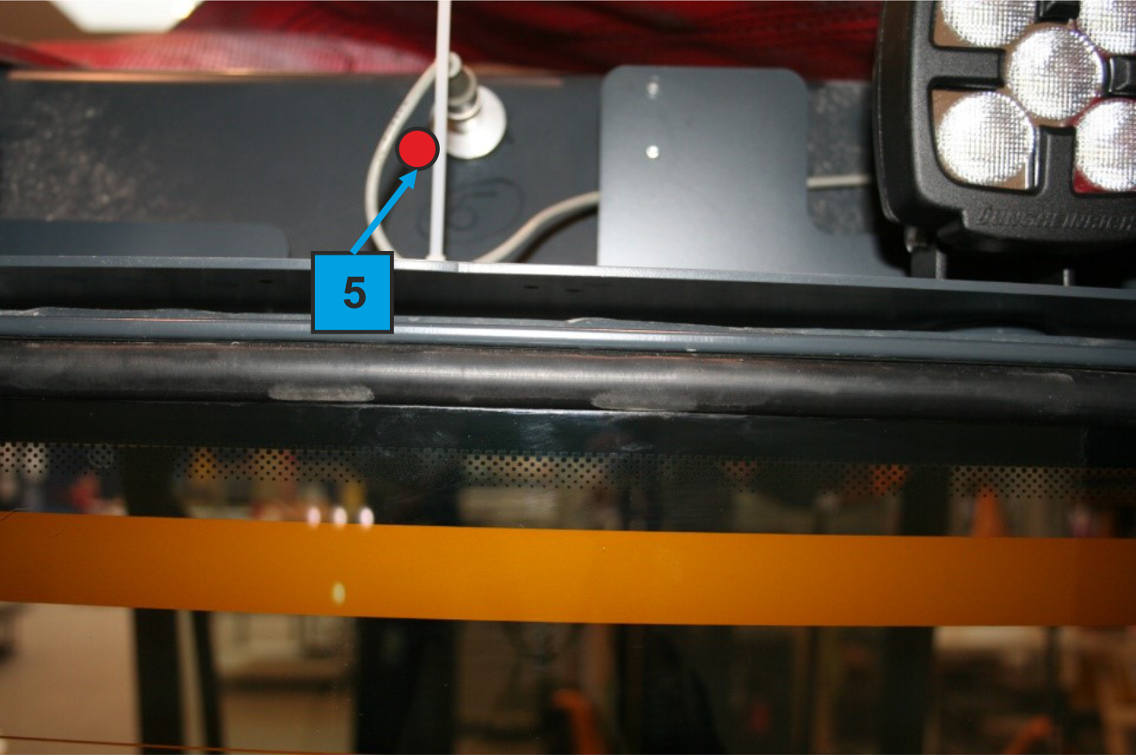
Position of sensor 5

Slide 15
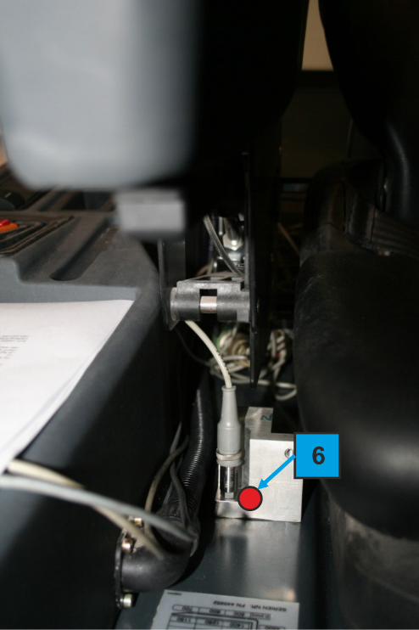
Position of sensor 6

Slide 16
MATLAB GUI
Experimental result data
Wheel load: 8000N and 16000N
Velocity: 2 km/h – 13 km/h
File extention: .asc
Data format: 7 columns
Acceleration (Sensor 1, m/s2)
Acceleration (Sensor 2 , m/s2)
Acceleration (Sensor 3 , m/s2)
Velocity (Sensor 4, km/h)
Acceleration (Sensor 5 , m/s2)
Acceleration (Sensor 6 , m/s2)
Time (s)
MATLAB GUI
Ploting all data
Calulate the displacement from sensor 1 and 2
Export (time, displacement)
File extention: .dat
File name: Exp_Stapler_f<force>_v<velocity>_h<threshold>.dat
Offset function to compare with simulation data (2 Column sim)

Slide 18
Vielen Dank für Ihre Aufmerksamkeit!
Prof. Dr.-Ing. Dipl.-Wi.-Ing. Willibald A. Günthner
Technische Universität München fml - Lehrstuhl für Fördertechnik Materialfluss Logistik
Boltzmannstr. 15
85748 Garching
Tel +49.89.289.15921 Fax +49.89.289.15922 E-Mail: kontakt@fml.mw.tum.de

